Slide 1
Ageing and HIV-
What is the Epidemiology and the Science
Judith A. Aberg, MD, FIDSA, FACP
Chief, Infectious Diseases, Mount Sinai Health System
George Baehr Professor of Medicine
Icahn School of Medicine at Mount Sinai

Slide 2
Disclosures
Advisory Board for Janssen, Merck, Viiv
Institutional Support: Frontier Technologies, Gilead Sciences, Shionogi and Viiv Healthcare/GlaxoSmithKline
No off-label product will be discussed

Slide 3
Introduction
Increased life expectancy on ART. However, life expectancies still shorter than for general population
  Especially for low CD4 and/or salvage regimens
Older persons may be diagnosed later and have more advanced HIV infection at presentation
There is a less robust immunologic response to antiretroviral therapy in this population
More likely to be treatment experienced with consequences of previous ART toxicities
What is the impact of increased life expectancy on comorbidity prevalence and types?

Slide 4
UNAIDS The GAP REPORT 2014
Most HIV Surveillance data do not include people over aged 50!
Health communication and health services are not geared towards people aged 50 and older living with HIV.
Clinicians are less likely to be trained on the specific needs of people 50 and older living with HIV.
The older population is likely to be diagnosed late in the course of HIV infection and often after their health has deteriorated considerably
https://www.unaids.org/sites/default/files/media_asset/12_Peopleaged50yearsandolder.pdf

Slide 5
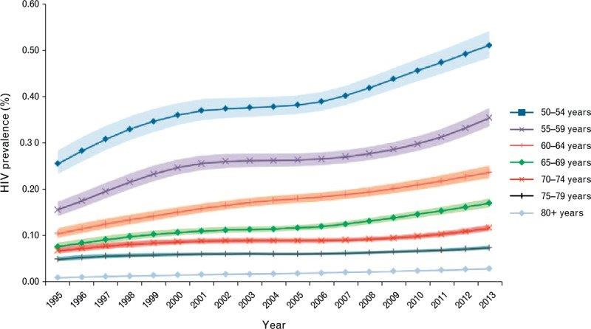
Global estimates of HIV prevalence of people 50 years and over, by age categories, 1995–2013

Slide 6

New HIV Diagnoses by Age United States, 2015
Under 50 years of age
50 years of age and over
Diagnoses of HIV Infection
Age
https://www.cdc.gov/hiv/group/age/olderamericans/index.html

Slide 7
People Living with HIV by Age United States, 2014
Under 50 years of age
50 years of age and over
45% aged ≥ 50 years
People Living with Diagnoses HIV
Age
https://www.cdc.gov/hiv/group/age/olderamericans/index.html

Slide 8
HIV Among People Aged 50 and older in US
Good News:
From 2010 to 2014, HIV diagnoses among all people aged 50 and over decreased by 10%.
Bad News:
Annual HIV infections among gay and bisexual men aged 55 and over increased 18% from 2010 to 2014 (from 1,100 to 1,300)
People aged 50 and older have the same HIV risk factors as younger people, but may be less aware of their HIV risk factors and are more likely diagnosed later in their disease
2,610 (39%) Deaths attributed to HIV were among people aged 55 and older.
https://www.cdc.gov/hiv/group/age/olderamericans/index.html

Slide 9
Mexico 2016
220,000 PWH with 60% accessing ART and approximately 90% are suppressed
Since 2010, new HIV infections have decreased by 22%
Ranks third in HIV prevalence of HIV in the Americas (behind US and Brazil) : 0.3% general population with greater than 10% among MSM
Approximately 10% new HIV diagnosis are in individuals over age 50

Slide 10
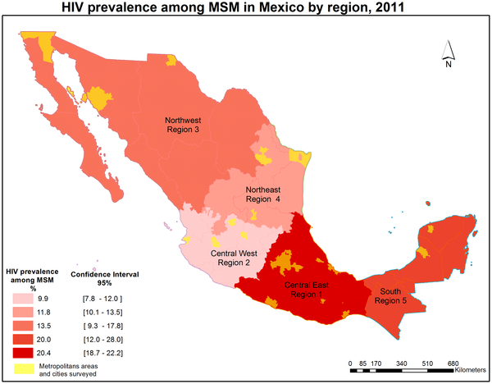

Figure 1. HIV prevalence by rapid testing among MSM in Mexico by region, 2011.
Bautista-Arredondo S, Colchero MA, Romero M, Conde-Glez CJ, Sosa-Rubí SG (2013) Is the HIV Epidemic Stable among MSM in Mexico? HIV Prevalence and Risk Behavior Results from a Nationally Representative Survey among Men Who Have Sex with Men. PLOS ONE 8(9): e72616. https://doi.org/10.1371/journal.pone.0072616
https://journals.plos.org/plosone/article?id=10.1371/journal.pone.0072616

Slide 11
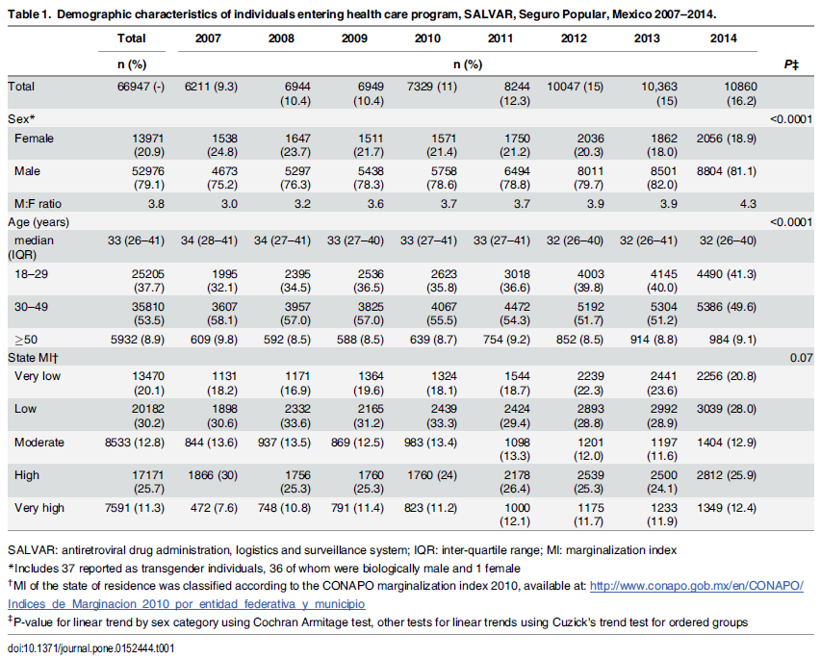
Table 1. Demographic characteristics of individuals entering health care program, SALVAR, Seguro Popular, Mexico 2007–2014.
Hernández-Romieu AC, del Rio C, Hernández-Ávila JE, Lopez-Gatell H, Izazola-Licea JA, et al. (2016) CD4 Counts at Entry to HIV Care in Mexico for Patients under the “Universal Antiretroviral Treatment Program for the Uninsured Population,” 2007–2014. PLOS ONE 11(3): e0152444. https://doi.org/10.1371/journal.pone.0152444
https://journals.plos.org/plosone/article?id=10.1371/journal.pone.0152444

Slide 12
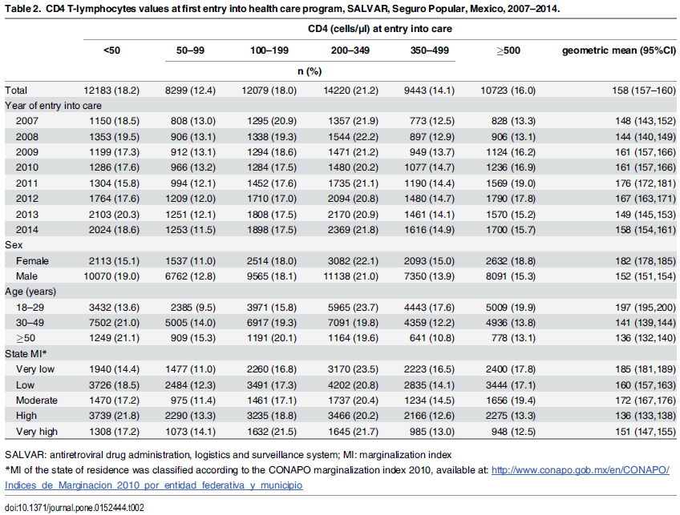
Table 2. CD4 T-lymphocytes values at first entry into health care program, SALVAR, Seguro Popular, Mexico, 2007–2014.
Hernández-Romieu AC, del Rio C, Hernández-Ávila JE, Lopez-Gatell H, Izazola-Licea JA, et al. (2016) CD4 Counts at Entry to HIV Care in Mexico for Patients under the “Universal Antiretroviral Treatment Program for the Uninsured Population,” 2007–2014. PLOS ONE 11(3): e0152444. https://doi.org/10.1371/journal.pone.0152444
https://journals.plos.org/plosone/article?id=10.1371/journal.pone.0152444

Slide 13
Health Conditions and Prescriptions
Cardiovascular: Arrhythmias, ASCVD, CHF, Transplant, Valvular HD
Endocrine: Bone, Diabetes, HLD, Hormonal
Kidney: Acute and Chronic; Transplant
GI/GU: Malignancies
Liver: HBV, HCV, NAFLD, Transplant
Lung: COPD, Malignancies; Transplant
Nervous System: Cognitive, Central vs Peripheral
Psychosocial: Depression, Substance Use

Slide 14
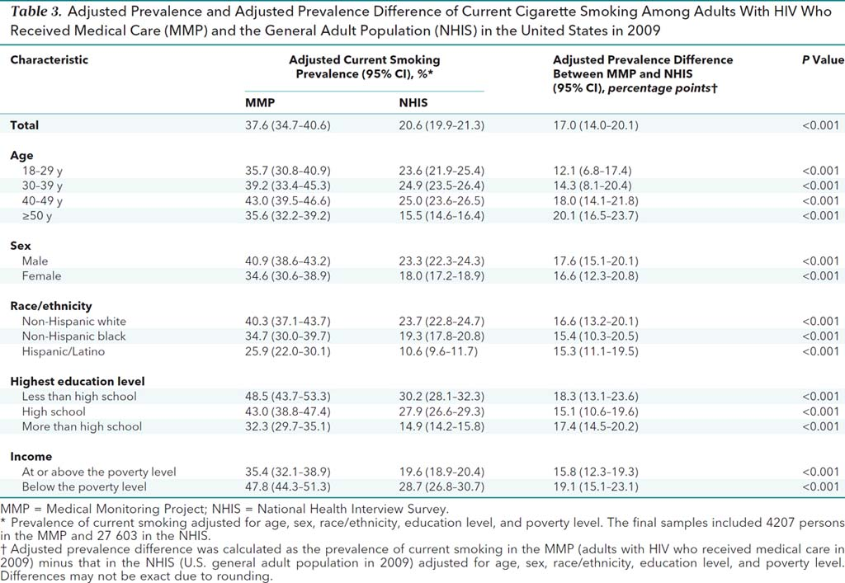
TOBACCO

Slide 15
HIV and Multimorbidity 2000-2009
Percentage of Individuals in HIV
Care with Age-Associated Conditions
N= | 4172 | 6325 | 8365 | 9121 | 9733 | 10861 | 11166 | 12277 | 9074 | 3705
No of conditions
1 | 1162 | 1705 | 2512 | 2833 | 3137 | 3517 | 3687 | 4004 | 2892 | 1195
2 | 287 | 452 | 727 | 923 | 1108 | 1375 | 1601 | 1756 | 1363 | 562
3 | 73 | 126 | 179 | 234 | 296 | 405 | 499 | 592 | 530 | 214
4 | 2 | 8 | 16 | 30 | 39 | 69 | 96 | 111 | 120 | 52
5 | 0 | 1 | 1 | 1 | 1 | 1 | 8 | 10 | 8 | 3
6 | 0 | 0 | 0 | 0 | 0 | 0 | 0 | 0 | 1 | 0
NAACORD Clin. Infect Dis 2017 Nov 15. doi: 10.1093/cid/cix998

Slide 16
Multimorbidity: older, white, and reported a history of heterosexual contact
2000
2009
Percentage of Individuals in HIV
Care with Age-Associated Conditions
Age at the Beginning of the Calendar Year
Age at the Beginning of the Calendar Year
1 comorbidities
2 comorbidities
31 comorbidities
4+ comorbidities
NAACORD Clin. Infect Dis 2017 Nov 15. doi: 10.1093/cid/cix998

Slide 17
Chronic Complications by Age and HIV Status 2002-2009
Cases
Controls
3%
1%
6%
4%
100%
1%
2%
6%
2%
8%
9%
16%
15%
17%
15%
17%
28%
31%
29%
75%
29%
35%
42%
50%
90%
80%
31%
60%
80%
31%
65%
42%
25%
40%
21%
0%
≤40 yrs
41 to 50 yrs
51 to 60 yrs
>60yrs
≤40 yrs
41 to 50 yrs
51 to 60 yrs
>60yrs
 | N=542 | N=1724 | N=452 | N=136
Pp prevalence | 3.9% | 9.0% | 20.0% | 46.9%
 | N=1626 | N=5172 | N=1356 | N=408
 | 0.5% | 1.9% | 6.6% | 18.7%
No age-related diseases
1 comorbidity
2 comorbidities
3comorbidities
4comorbidities
Guaraldi G, Orlando G, Zona G et al. Clin Infect Dis 2011;53:1120
Guaraldi G Clin Infect Dis Dec;53(11):1120-6

Slide 18
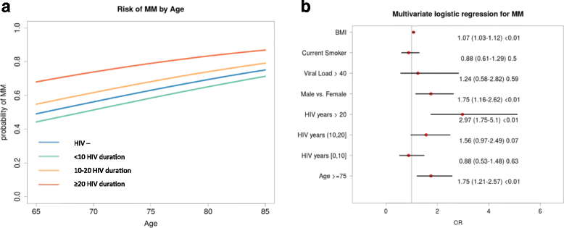
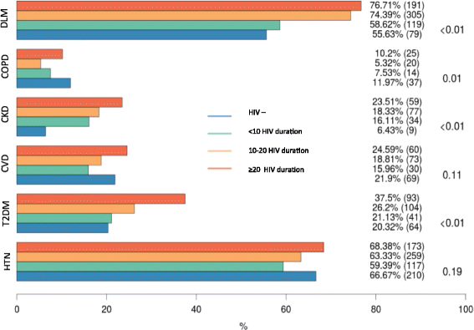
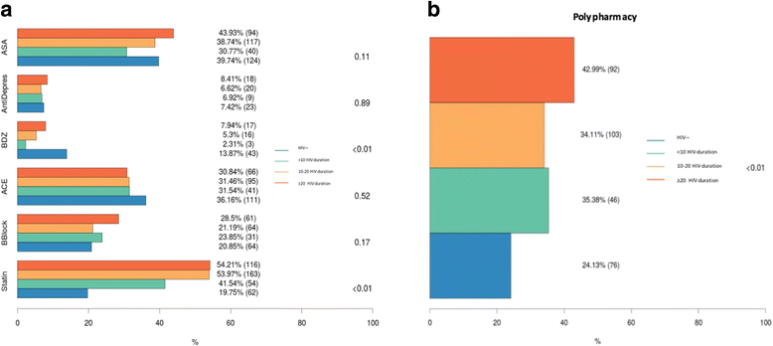
Geriatric PLWH (GEPPO)

Slide 19
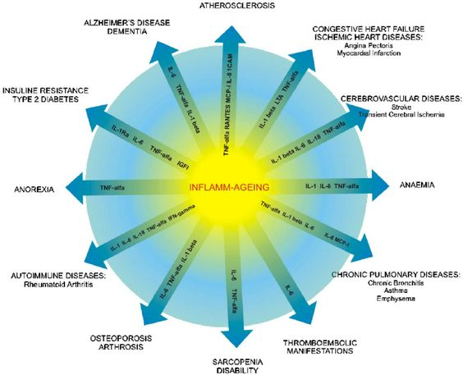
“Inflamm-Aging”
ATHEROSCLEROSIS
ALZHEIMER’ DISEASE
DEMENTIA
CONGESTIVE HEART FAILURE
ISCHEMIC HEART DISEASES:
Angina Pectoris
Myocardial Infarction
INSULIN RESISTANCE
TYPE 2 DIABETES
CEREBROVASCULAR DISEASES
Transient Cerebral Ischemia
Stroke
ANOREXIA
INFLAMM-AGING
ANAEMIA
AUTOIMMUNE DISEASES
Rheumatoid Arthritis
CHRONIC PULMONARY DISEASES
Chronic Bronchitis
Asthma
Emphysema
OSTEOPOROSIS
ARTHROSIS
THROMBOEMBOLIC
MANIFESTATIONS
SARCOPENIA
DISABILITY
Franceschi_Inflamm-aging An Evolutionary perspective
on immunosenescence_Ann N Y Acad Sci. 2000;908:244-54

Slide 20


Immunological and clinical manifestations shared by PWH and healthy elderly
Immunologic characteristics
Naïve T cells, T cell diversity, Memory cells, Telomere length and monocyte function
Differentiated, senescent CD8+ T cells and CD16+ monocytes
Functional immune defects
Replicative capacity
Tumor surveillance
Pathogen protection
Chronic inflammation
Clinical manifestations
Vaccine responses
Infections
Age-associated non communicable diseases
S. Crowe Burnet Institute, derived from Hearps et al AIDS 2012, 26:843–853
Notes:
There are a number of immunologic and clinical features of ageing that are shared by HIV infected individuals and the elderly.
There is good evidence that changes occur in T cells as we age such as the accumulation of senescent T cells and emerging evidence of changes in monocytes.
These changes are juxtaposed on evidence of chronic inflammation
and clinically associated with increased risk of infection as well as non communicable diseases of ageing

Slide 21
Shorter CD8 T cell Subset Telomeres and Lower Proliferative: Senescent CD8 Ratio in People with Chronic/Latent Viral Coinfections (Comorbidities in Women and Children Cohort (CARMA)
Immune activation
Immune aging
HIV
Chronic inflammation
Age-related comorbidities
Cytomegalovirus
CMV
HHV
Other human herpesviruses
Hepatitis C virus
HCV
VZV
Varicella zoster virus
Hepatitis B virus
HBV
HSV
Herpes simplex viruses
Epstein-Barr virus
EBV
Hsieh AYY, Côté HCF TUPEB191 IAS 2019

Slide 22
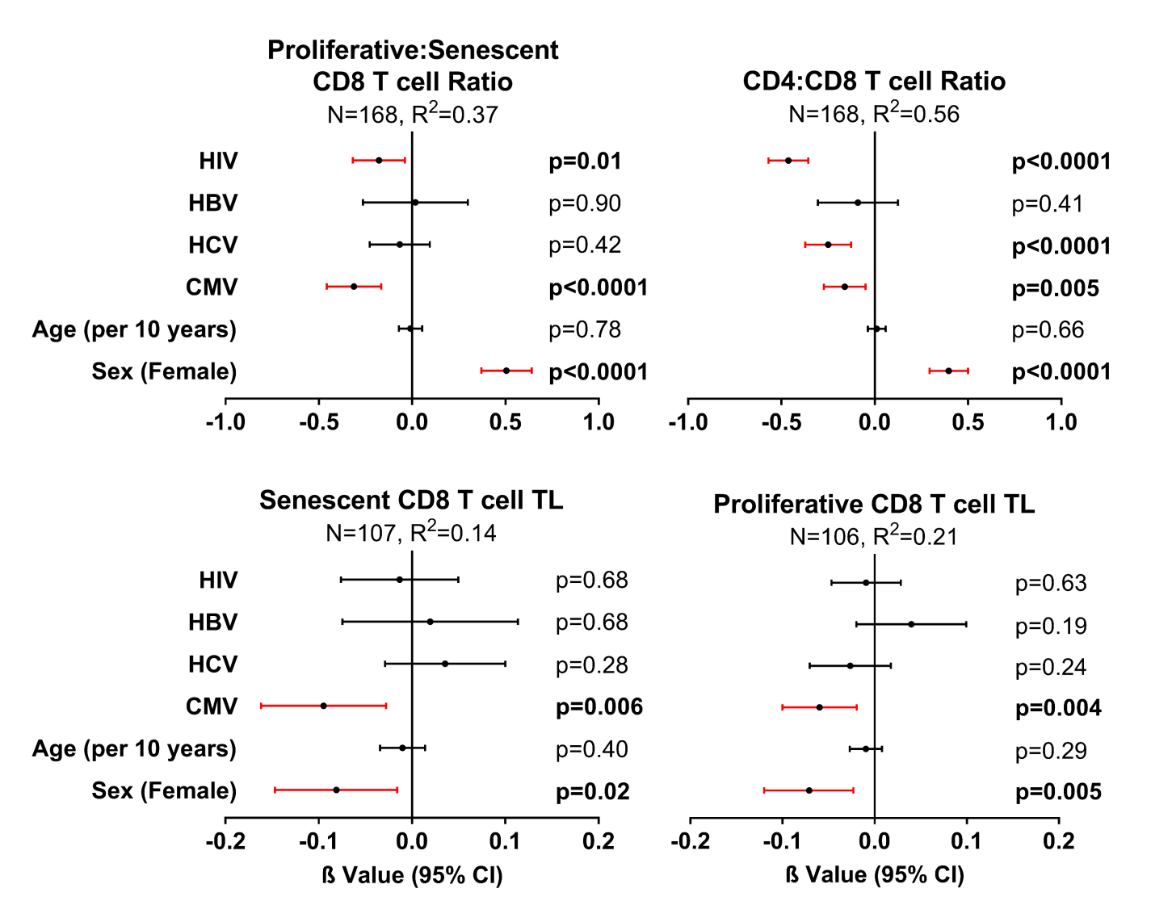
Specific chronic/latent viruses may affect T cell ratios and CD8 T cell TL
After adjusting for age and sex:
HIV and CMV associated with lower proliferative:senescent CD8 ratio
HIV, HCV, and CMV associated with lower CD4:CD8 ratio
CMV infection associated with shorter CD8 T cell subset TL
Hsieh AYY, Côté HCF, unpublished data, TUPEB191 IAS 2019

Slide 23
Model of heightened blood thrombogenicity in ART-treated HIV infection

Slide 24
Platelets are more hyper-reactive to platelet agonists
Sci Adv. 2019 Jun 12;5(6):eaav5463

Slide 25
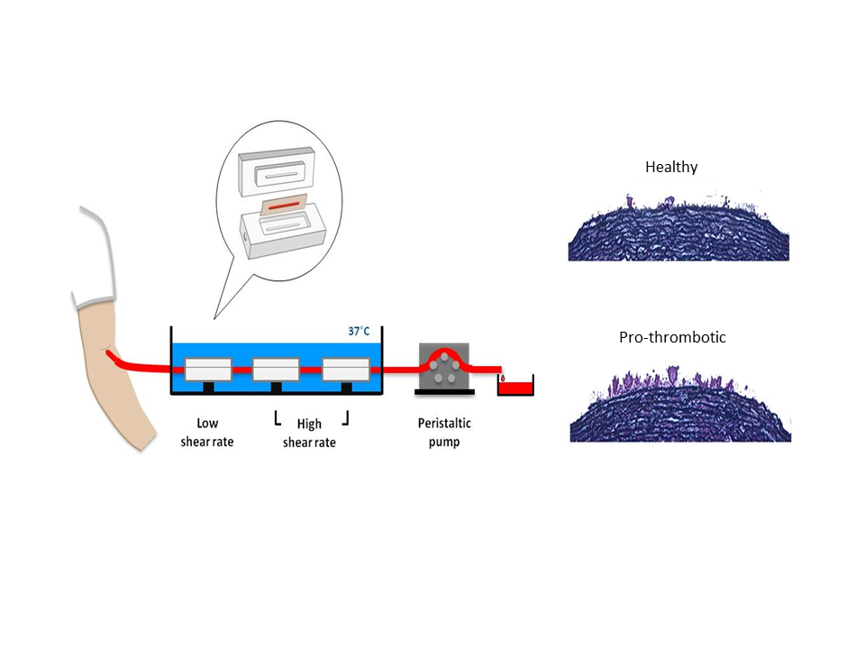

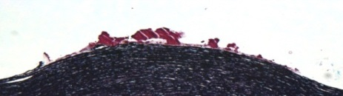
Blood thrombogenicity is markedly increased in HIV-infected patients
A.
C..
HIV(-)
HIV(+)
B.
D.
Sci Adv. 2019 Jun 12;5(6):eaav5463

Slide 26
In PWH blood thrombogenicity is significantly associated with inflammatory biomarkers
Sci Adv. 2019 Jun 12;5(6):eaav5463

Slide 27
Study Summary
PWH on ART:
  Induced more thromboses formation regardless of shear force
    Women HIV+ induced more thromboses formation under high shear than Men HIV+
    Platelets were more reactive to platelet agonists
  Thromboses formation under high shear conditions correlated with plasma markers of inflammation
    Pos. correlation with non-classical monocytes but a neg. correlation with classical monocytes
O’Brien M. Sci Adv. 2019 Jun 12;5(6):eaav5463

Slide 28
Biomarkers of Inflammation and Coagulation
Persons with HIV-1 have increased levels of hs-CRP, TNF alpha (TNF-α), IL-6, d-dimer and other biomarkers compared with people without HIV.
These elevations in biomarkers persist even after virologic suppression, likely due to HIV-induced activation of inflammation and coagulation pathways.
Levels of TNF-α, IL-6, hs-CRP and other proinflammatory cytokines are associated with HIV-1 viral load and may predict disease progression, as well as correlate with a higher risk of CVD and all-cause mortality.
To date, no markers have been found to be both predictive of comorbidity risk and responsive to HIV VL suppression or risk factor modification in PWH
Kaplan-Lewis E. Current HIV/AIDS Reports 2016;13:297-308

Slide 29
Ideal Qualities Desired for Surrogate Markers
Must Predict Clinical Outcomes or Disease e.g. clinically meaningful
Reflects the key pathophysiologic process mediating the risk of disease
Must be responsive to interventions
Good reproducibility (both within a sample and within an individual)
Fleming DR and DeMets, DL, 1996; Ann Mem Med. 1996; 125:605-613.
Strimbu. K and Tavel, JA. M.D, Curr Opin HIV AIDS. 2010 November ; 5(6): 463–466
Fleming, DR and Powers, JH; Stat Med. 2012 November 10; 31(25): 2973–2984.
http://www.conversantbio.com/blog/bid/383664/5-Core-Characteristics-of-Surrogate-Endpoint-Biomarkers
Evaluation of Biomarkers and Surrogate Endpoints in Chronic Disease, 2010, www.iom.edu/biomarkerevaluation
Clinical Trial Endpoints, Sullivan, EJ,; USA Food and Drug Administration
Outcome Measures, Biomarkers and Endpoints, McCune, S, USA Food and Drug Administration, 2016

Slide 30
Summary
HIV infection, even when controlled, is associated with chronic immune activation that is superimposed upon immunologic senescence in the older adult
Older persons may be diagnosed later and have more advanced HIV infection at presentation
There is a less robust immunologic response to antiretroviral therapy in this population
People with HIV accumulate “age-related” diseases at a younger chronological age and these conditions account for majority of deaths
Providers need guidance on how best to manage PWH with comorbidities : manifestations, drug interactions, drug vs disease vs host interplay

Slide 31
ACKNOWLEDGEMENT
Innumerable Thanks to all the Study Participants
Mount Sinai Clinical and Translational Research Center
Michelle Cespedes
Emma Kaplan-Lewis
Ana Ventuneac
Mount Sinai Atherosclerosis Research Unit
  Juan Badimon
  Urooj Zafar
  Jose C. Rodriguez

